Slide 1




Powerbi_project
View in Power BI
Report by:
Roshini Bandi
Last data refresh:
13-01-2024 22:57:57 UTC
Downloaded at:
13-01-2024 23:37:41 UTC

Slide 2

ZOMATO DATA ANALYSIS
The goal of analyzing the Zomato dataset is to understand the factors affecting restaurant ratings. With rising demand, new restaurants find it challenging to surpass established ones, often serving similar cuisine.
Researching local demographics becomes crucial to identify popular cuisines. The data allows for in-depth analysis of these factors.

Slide 3
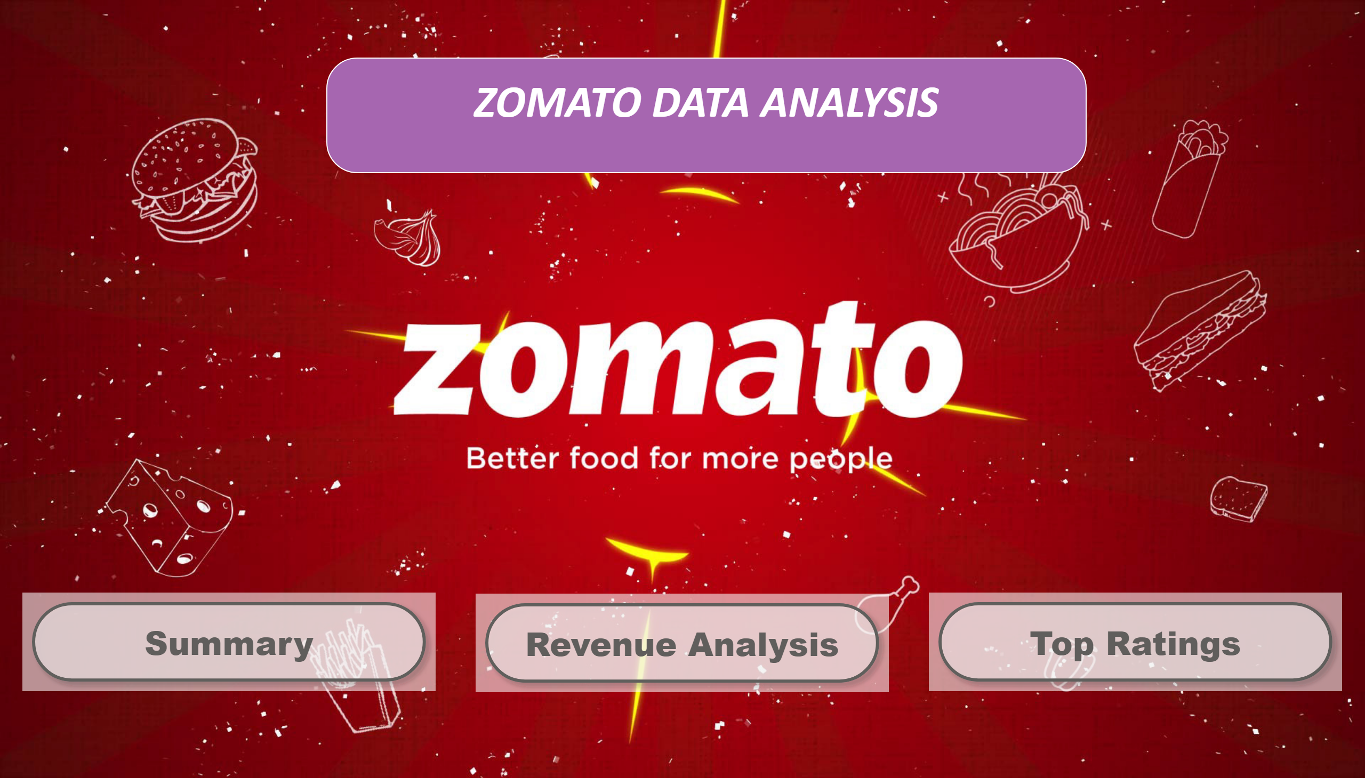
Zomato Data Analysis
Notes:
textbox
No alt text provided
actionButton
No alt text provided
actionButton
No alt text provided
actionButton
No alt text provided

Slide 4
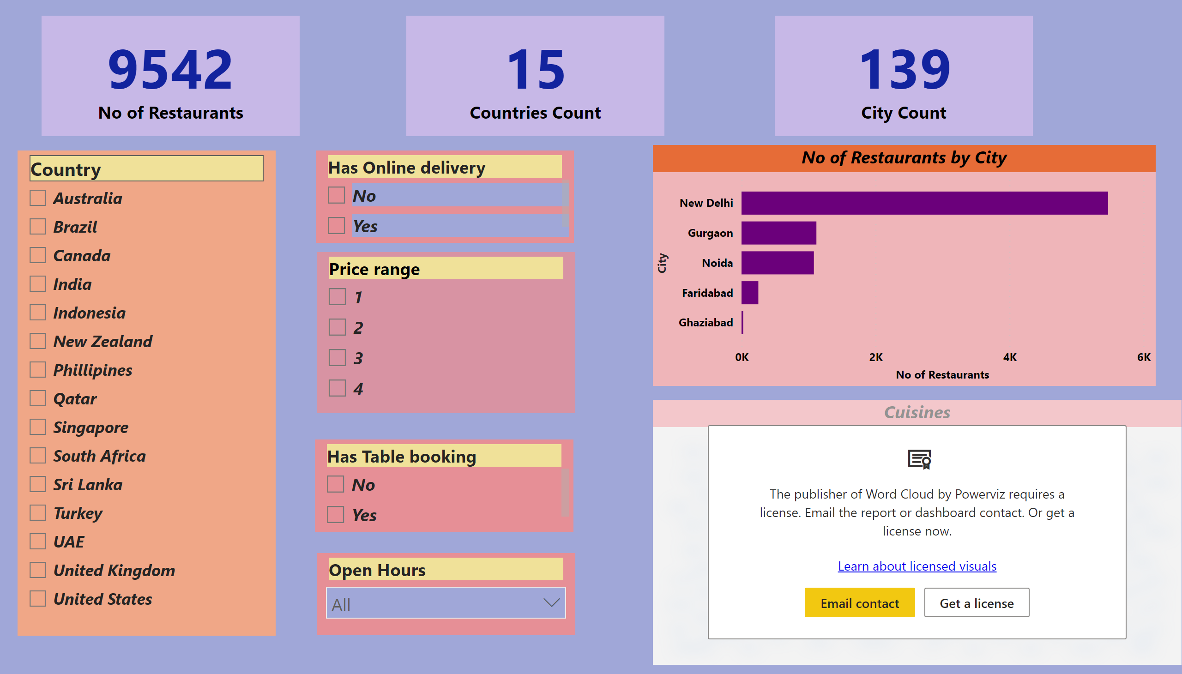
Summary
Notes:
slicer
No alt text provided
slicer
No alt text provided
slicer
No alt text provided
slicer
No alt text provided
slicer
No alt text provided
barChart
No alt text provided
WordCloud5550983e166911eebe560242ac120002
No alt text provided
card
No alt text provided
card
No alt text provided
card
No alt text provided

Slide 5
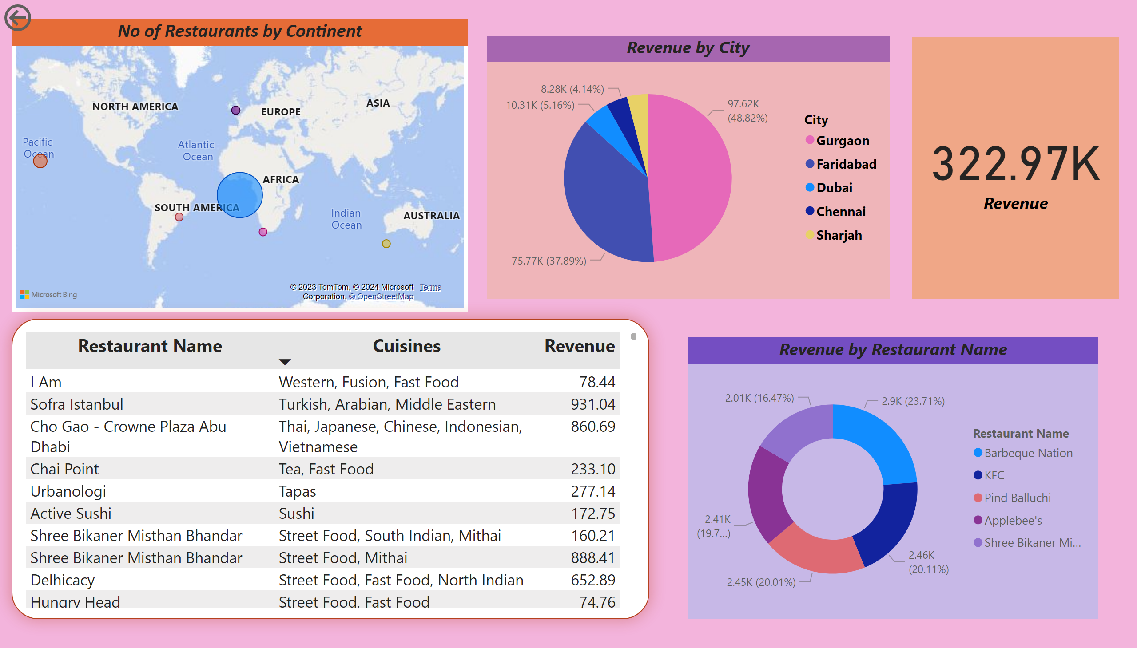
Revenue Analysis
Notes:
No of Restaurants by Continent
No alt text provided
actionButton
No alt text provided
tableEx
No alt text provided
pieChart
No alt text provided
donutChart
No alt text provided
card
No alt text provided

Slide 6
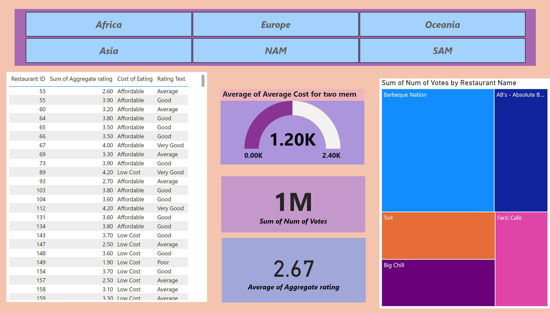
Top Ratings
Notes:
slicer
No alt text provided
tableEx
No alt text provided
treemap
No alt text provided
gauge
No alt text provided
card
No alt text provided
card
No alt text provided

Slide 7
CONCLUSION
Zomato stands out with its unique selling proposition (USP) - a vast menu selection. This extensive offering allows Zomato to provide comprehensive details like location, reviews, ratings, and more for virtually every restaurant. The key factor that distinguishes Zomato from its competitors is its directory of information, empowering customers to research nearby restaurants and cafes thoroughly.

